Slide 1
Shell Bootcamp 2024 3 Reflections for Week #<>
Zainab Mujtaba
Date : 14-Sept-2024

Slide 2

About Me
“Success is not final, failure is not fatal: It is the courage to continue that counts.” - Winston Churchill
Please share an image / visual that best represents you

Slide 3

My learnings from this week!

Slide 4
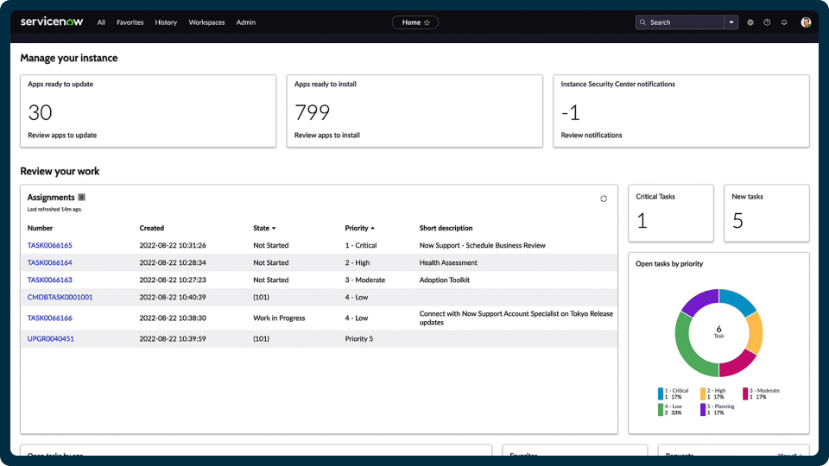
Learning 1 | My takeaways
ITIL:- (Information Technology Infrastructure Library) is a globally recognized framework for IT Service Management that provides best practices to align IT services with business needs.
Key take away ServiceNow is a cloud-based platform that automates ITSM processes, helping organizations manage and streamline their IT workflows based on ITIL practices.
Impact on Compliance and Risk Management ITIL and ServiceNow help energy companies meet strict regulations by managing IT and operational risks, automating reporting, and improving service delivery.

Slide 5
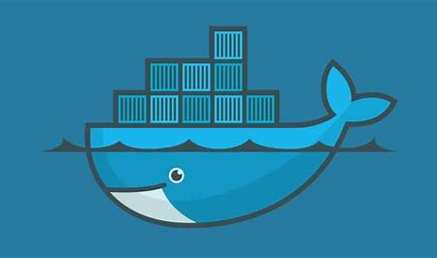
Learning 2 | My takeaways
Key Learning about Docker- Docker allows developers to package applications and their dependencies into containers, ensuring consistent performance across different environments.
Key Takeaway about Docker- Docker enhances portability, scalability, and efficiency by creating isolated environments for applications, similar to virtual machines but with less overhead.
Implementation in the Energy Sector
- **Data Analysis & Monitoring**: Deploy tools like Grafana and Prometheus for real-time monitoring.
- **Microservices Architecture**: Develop and scale components independently.

Slide 6

Learning 3 | My takeaways
Key Learning: Azure Virtual Machines (VMs) provide scalable, on-demand computing resources, allowing for flexible virtualization without the need for physical hardware¹.
Key Takeaway: Azure VMs offer cost-effective, scalable, and reliable solutions for running applications and managing workloads in the cloud².
Implementation in the Energy Sector: Use Azure VMs for complex simulations and modeling, enhancing decision-making and operational efficiency. Deploy VMs to process and analyze large datasets, improving energy production and consumption insights.

Slide 7

Relevance of learnings for my organization

Slide 8
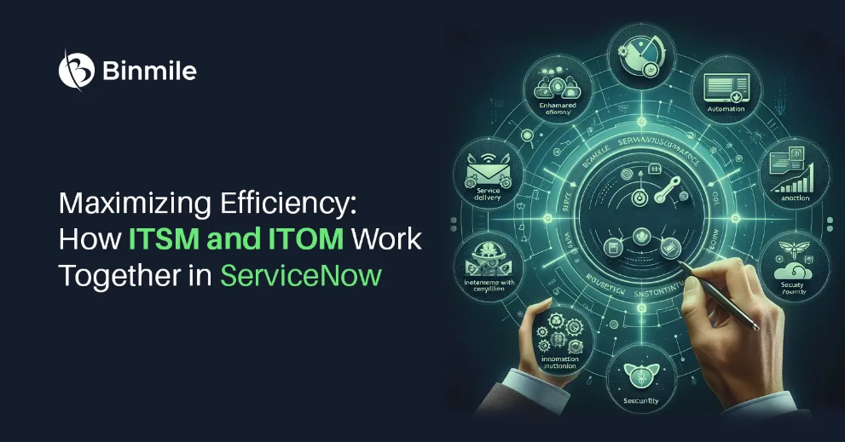
Learning 1 | Relevance for Shell
A comprehensive catalog on ServiceNow allows easy service requests and tracking. ServiceNow helps track incidents, resolve issues, and prevent recurring problems. ServiceNow manages changes and maintains a knowledge base for troubleshooting and best practices. Automation reduces manual effort and costs. IT services align with business needs, improving delivery and compliance. Insights from ServiceNow support better IT decisions.
Shell benefits from streamlined IT operations, improved service, and cost efficiency using ITIL and ServiceNow.

Slide 9
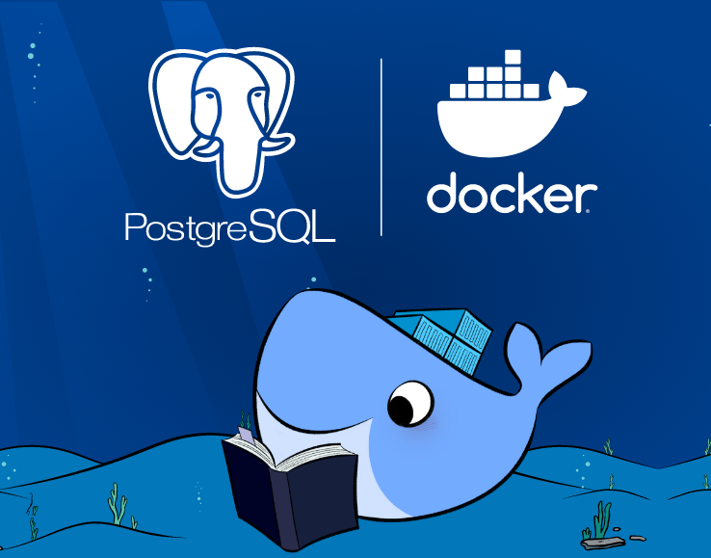
Learning 2 | Relevance for Shell
*Implementation:-
**Data Analysis & Monitoring**: Deploy tools like Grafana and Prometheus for real-time monitoring.
- **Microservices Architecture**: Develop and scale components independently.
**Simulation & Modeling**: Run consistent simulations for better planning.
**Benefits:**
- **Enhanced Efficiency**: Streamlined deployment and management of applications.
- **Cost Reduction**: Lower infrastructure and operational costs.
- **Scalability**: Easily scale applications to meet demand.

Slide 10
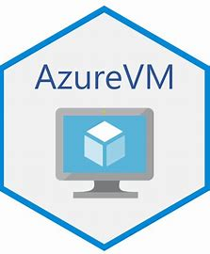
Learning 3 | Relevance for Shell
Implementation:
- Shell uses Azure VMs for complex simulations and modeling, enhancing decision-making and operational efficiency.
- Deploys VMs to process and analyze large datasets, improving insights into energy production and consumption.
- Benefits:
- Streamlined deployment and management of applications.
- Lower infrastructure and operational costs.

Slide 11

Challenges in implementing learning

Slide 12
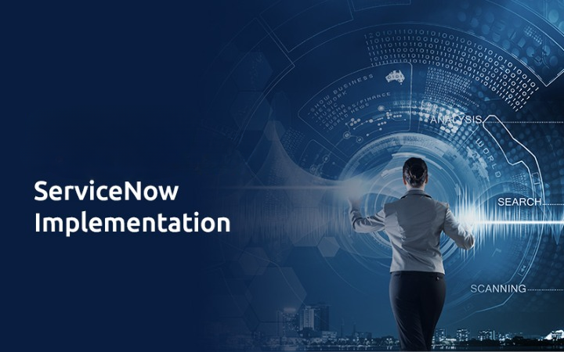
Challenge faced while implementing Learning 1
During training on ITIL and ServiceNow, one challenge can be the sheer depth and complexity of the ITIL framework. Learning how to apply these detailed processes to align IT services with business needs requires understanding various ITSM principles, which can be overwhelming. Moreover, grasping how ServiceNow integrates and automates these processes to manage workflows adds an additional layer of difficulty. This can lead to confusion about where and how to start, particularly when dealing with real-world scenarios, making it hard to immediately visualize the practical application of these concepts.

Slide 13
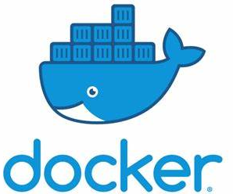
Challenge faced while implementing Learning 2
Challenges Faced:
1. Complexity of Environment: Managing numerous containerized components.
2. Security Issues: Ensuring secure deployment and configuration.
3. Resource Management: Efficiently allocating resources.
4. Skill Gaps: Finding skilled personnel in Docker.
Plans to Overcome Them:
1. Automation and Orchestration: Use tools like Kubernetes.
2. Enhanced Security Practices: Regular vulnerability scanning and secure images.
3. Resource Monitoring Tools: Track resource usage and performance.
4. Training and Development: Upskill workforce and hire experts.

Slide 14

Challenge faced while implementing Learning 3
Challenges Faced and Plans to Overcome Them
While implementing Learning 3, I faced challenges such as managing the complexity of numerous containerized components, ensuring secure deployment and configuration, efficiently allocating resources, and finding skilled personnel in Docker. To overcome these, I plan to use automation and orchestration tools like Kubernetes, adopt enhanced security practices including regular vulnerability scanning and secure images, utilize advanced resource monitoring tools, and invest in training programs to upskill the workforce and hire experts.

Slide 15

Action Plan

Slide 16
My Action Plan for this Week
Actions
Timeline
Status
The first action is to listen and ask relevant questions during the training.
Try implementing whatever we learn.
Keep practicing the concepts to solidify them.
The planned timeline to implementThe planned time line is what ever we learnt implemented and practiced everyday.
In the weekend try to combine the different concepts we learnt throughout the week or this week.
the actions
Done the practice and learning part.
The goal for the weekend is to try the combinations of the different learnings that we have done.

Slide 17

Learning is also Fun!

Slide 18

Learning is also Fun!
This week’s classes were very interactive and informative. All the lessons were in depth and backed by example along with practical implementation during the class it-self.
The faculty also checked whatever we implemented and cleared any doubts we had.

Slide 19

Summary
Importance of Topics for the Upcoming Week
The upcoming week's topics are crucial as they build on the foundational knowledge of Docker, Azure VMs, and ServiceNow. Understanding advanced container orchestration with Kubernetes, optimizing Azure VM performance, and integrating ServiceNow with other cloud services will enhance your ability to manage complex IT environments efficiently. These topics will provide deeper insights into scalability, automation, and seamless service management, which are essential for modern IT infrastructure.
Connectivity of Topics from the Current Week
This week's learnings on Docker, Azure VMs, and ServiceNow are interconnected through their roles in cloud computing and IT service management. Docker containers can be deployed on Azure VMs to create scalable and portable applications. ServiceNow can be integrated with Azure to automate IT workflows and manage cloud resources effectively. Together, these technologies enable a cohesive and efficient approach to managing and deploying applications in the cloud, ensuring reliability and performance.
By mastering these concepts, you'll be well-equipped to handle the complexities of modern IT environments, driving efficiency and innovation in your projects.

Slide 20
Thank You

